Slide 1
Language technology for low-resource languages
Day 5/5
LOT 2018, Groningen
Yves Scherrer, University of Helsinki

Slide 2
Cross-lingual tagging with character embeddings
Use related languages
Adapt the HRL tagger to LRL by including a small number of annotated LRL sentences
Full morphological tagging
R. Cotterell & G. Heigold (2017): Cross-lingual Character-Level Neural Morphological Tagging. Proceedings of EMNLP.

Slide 3
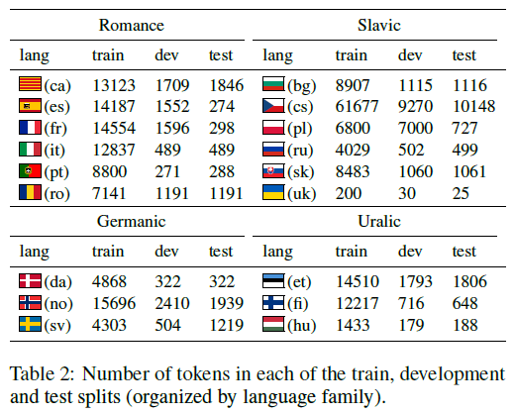
Cross-lingual tagging with character embeddings

Slide 4
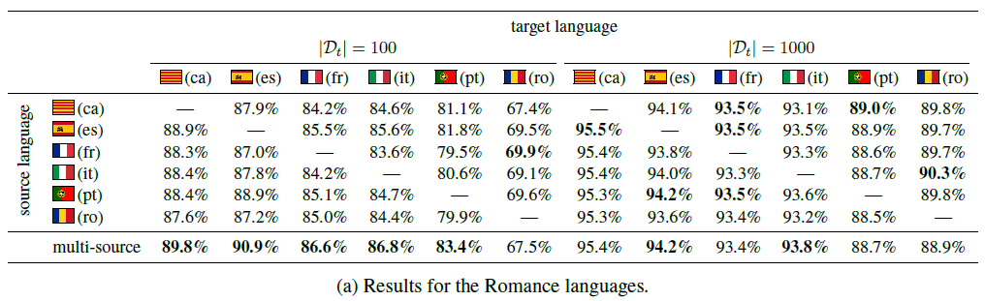
Cross-lingual tagging with character embeddings
Results for Romance languages (100 LRL training sentences):

Slide 5
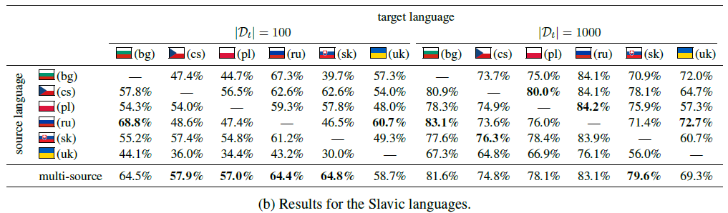
Cross-lingual tagging with character embeddings
Results for Slavic languages (100 LRL training sentences):

Slide 6
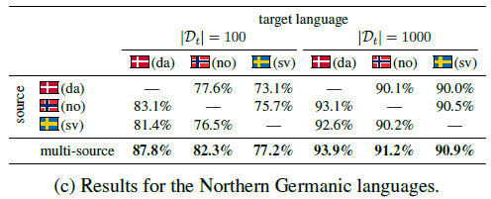
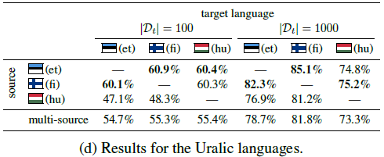
Cross-lingual tagging with character embeddings
Results for Northern Germanic languages:
Results for Uralic languages:

Slide 7
Cross-lingual tagging with character embeddings
No parallel data, no dictionary mappings, but small annotated LRL training set
Model adaptation approach
Some missing baselines:
Train on only 100 LRL sentences, without HRL data
Train only on HRL data without LRL sentences
In the absence of these comparisons, results look rather low for most languages
Cross-lingual character embedding mappings?

Slide 8
Why not use all source languages?

Slide 9
Why not use all source languages?

Slide 10
Why not use all source languages?

Slide 11
Multilingual models
Is there manually annotated training data?
Which language(s)?
How many languages?
yes
no
Use supervised NLP techniques
Is there relevant training data from other languages?
yes
no
Use cross-lingual learning methods
Are there monolingual corpora?
yes
no
Use unsupervised NLP techniques
Annotate data
Collect and annotate data
Adapted from Y. Tsvetkov

Slide 12
Multilingual models
Plain model transfer
Scherrer & Rabus 2017 (done)
Character embeddings + adaptation
Cotterell & Heigold 2017 (done)
Annotation projection
Agić et al. 2015
Delexicalization
McDonald et al. 2011
Ammar et al. 2016

Slide 14

If all you have is a bit of the Bible…
Ž. Agić, D. Hovy, A. Søgaard (2015): If all you have is a bit of the Bible: Learning POS taggers for truly low-resource languages. ACL 2015.
http://www.domnik.net/photos/kuvia/000/big/006/51-kampinkappeli.jpg

Slide 15
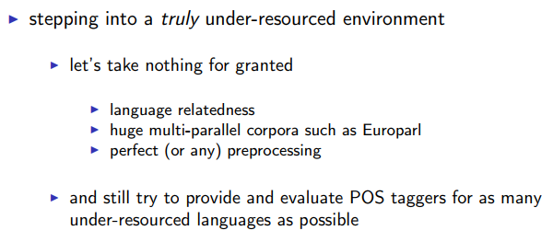
If all you have is a bit of the Bible…
Ž. Agić, D. Hovy, A. Søgaard (2015): If all you have is a bit of the Bible: Learning POS taggers for truly low-resource languages.
Motivation:
Notes:
Where do you get Bible translations from?

Slide 16
If all you have is a bit of the Bible…
Translations of parts of the Bible exist for a huge number of languages:
Edinburgh Bible parallel corpus: 100 languages [used here] http://homepages.inf.ed.ac.uk/s0787820/bible/
Parallel bible corpus: 1169 languages/varieties http://paralleltext.info/data/
Web sources: 1646 languages http://www.bible.is/
Sentence alignments are easy to obtain: verse IDs
Split into k high-resource languages and m low-resource languages, project from all k to all m: multi-source projection

Slide 17
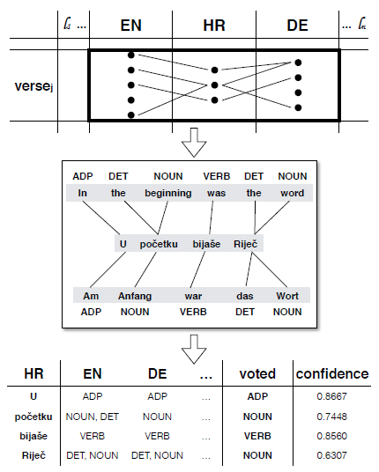
If all you have is a bit of the Bible…

Slide 18
If all you have is a bit of the Bible…
Iterative process:
Tag the k high-resource language Bibles. Project tags from k languages to m languages. Choose tags by majority voting.
Train taggers for m low-resource languages using the projected data and tag the m low-resource languages (self-training). Project tags from (k+m)-1 to other (k+m)-1 languages. Choose tags by majority voting.
Train taggers for k+m languages using the projected data.
k = 18 languages, m = 82 languages

Slide 19
If all you have is a bit of the Bible…
Low-resource languages include Akawaio, Aukan, Cakchiquel, Ewe, Haitian Creole, Manx, Maori, Somali, Ukrainian, …
How do you evaluate this?
Test sets available for 25 languages
Wiktionary data available for 10 more languages → Compute to what extent the projected tag dictionaries overlap with the Wiktionary data

Slide 20
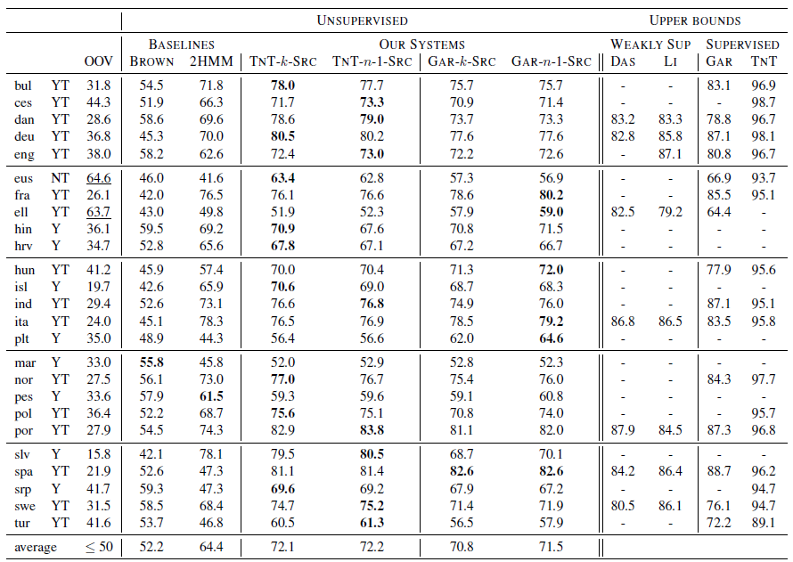

Slide 21
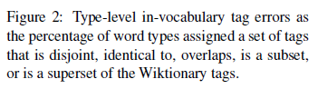
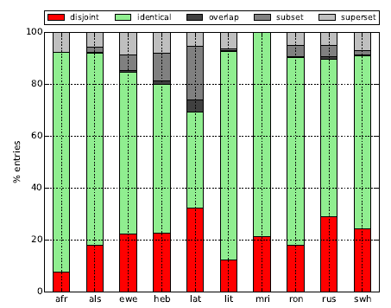
Evaluation

Slide 23
McDonald et al. 2011
Blue: irrelevant here
Green: delexicalized parser trained on English
Yellow: delexicalized parser trained on English, corrected by annotations projected from English
Notes:
Is English always the best choice of source language? Which language would you choose?

Slide 24
McDonald et al. 2011
Is English always the best choice as a source language?

Slide 25
McDonald et al. 2011
It is difficult to choose the optimal source language... Why not use all source languages?
multi-dir: all languages except the target language, direct transfer (delexicalized)

Slide 26
McDonald et al. 2011
It is difficult to choose the optimal source language... Why not use all source languages?
multi-proj: all languages except target language, with projection

Slide 28
Multilingual models???
The models presented up to here use multiple high-resource languages to annotate a single low-resource language
For the Bible model, k+m distinct taggers are trained
Can we create a single unified model that is able to tag/parse several (low-resource) languages?
W. Ammar et al. (2016): Many languages, one parser. TACL 4, 2016, 431-444.

Slide 29
Many languages – one parser
Basic model:
Model transfer with language-independent word representations
What do we need?
Treebanks in all source languages with consistent annotations (UD)
Multilingual word embeddings
Multilingual word clusters
Consistent POS tag annotation for delexicalization
Language-specific information

Slide 30
Many languages – one parser
How should NOUN ADJ NOUN be parsed?
Some training examples contain prenominal adjectives, some contain postnominal adjectives
Depends on the proportion of examples
But it should depend on the test language...
Proposed solution:
Label each word (during training and testing) with a language label
The model embeds the language labels, so syntactically similar languages should end up having similar language embeddings

Slide 31
Many languages – one parser
Evaluated on DE, EN, ES, FR, IT, PT, SV
Three scenarios:
Big treebank: Use complete treebanks from all languages, including test language (supervised scenario)
Small treebank: Use full English treebank + reduced treebank of the test language (3000 tokens, adaptation scenario)
No treebank: Use treebank from all languages excluding test language (low-resource language scenario)

Slide 32
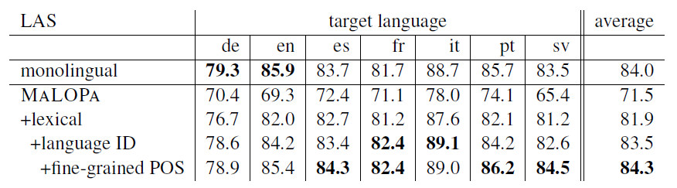
Results Big treebank scenario
MaLOPa: completely delexicalized
+lexical: with multilingual embeddings/clusters
+fine-grained POS: added language-specific morphosyntactic distinctions

Slide 33
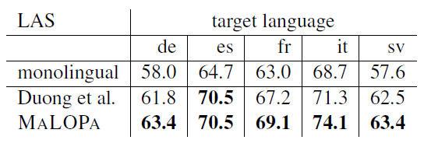
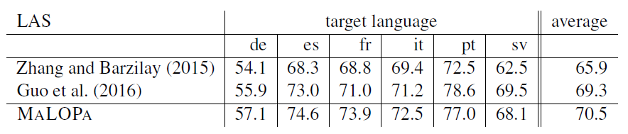
Results
Small treebank scenario:
No treebank scenario:

Slide 34
Language labels...
In multilingual models, it is useful to add language labels to guide the model
either on each word, or one per sentence
What happens in the “no treebank” scenario?
The label of the test language has not been seen at all during training, and thus is not helpful.
What can we do?

Slide 35
Language labels backwards...
Instead of providing the language labels as input features, force the model to predict the language of each word
Predict POS tag + language label: multitask learning
This forces the model to distinguish between the languages during training
At test time, no additional input information is required, but language labels will be output
In the “no treebank” scenario, these labels may correspond to anything and are not relevant

Slide 36
Multitask learning
What are the conditions for converting an input feature to an auxiliary task?
Must be learnable from the remaining input features
Example:
A typical parser relies on POS tags as input features
Conversion to multitask learning: Learn to predict POS tag and dependency relation at the same time

Slide 37
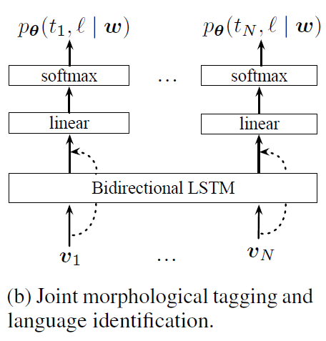
Multitask learning
The Cotterell & Heigold tagger actually uses language labels as auxiliary task
Bilingual model:
Source language
100 sentences of target language

Slide 39
What about machine translation?
Until now, we mostly talked about sequence labeling tasks (tagging, parsing, ...)
We assumed that MT systems / parallel corpora were more readily available than syntactically annotated corpora
What if these assumptions do not hold?
No parallel data for a particular language pair, but for several other language pairs: zero-shot translation
No parallel data at all: unsupervised translation

Slide 40
Zero-shot machine translation
Traditional setup:
Train a distinct model for each language pair and direction
Proposed setup:
Train a single model for all language pairs and both directions
Add target language labels to tell the model what language to translate into
Hello, how are you?
<2es> Hello, how are you?
Hola, ¿cómo estás?
Melvin Johnson et al. (2017): Google's multilingual neural machine translation system - enabling zero-shot translation. TACL 5/2017.

Slide 41
Zero-shot machine translation
Proposed experiment: 12 language pairs
English -> Japanese + Japanese -> English
English -> Korean + Korean -> English
English -> Spanish + Spanish -> English
English -> Portuguese + Portuguese -> English
English -> German + German -> English
English -> French + French -> English
Does such a multilingual model do better on translating a seen language pair than a standard model?
No

Slide 42
Zero-shot machine translation
Proposed experiment: 12 language pairs
English -> Japanese + Japanese -> English
English -> Korean + Korean -> English
English -> Spanish + Spanish -> English
English -> Portuguese + Portuguese -> English
English -> German + German -> English
English -> French + French -> English
This model can be used for an unseen language pair:
French -> German
Spanish -> Japanese ...

Slide 43
Zero-shot machine translation
Zero-shot translation: No explicit training data from the language pair, but...
... the source language has been seen during training (with another target language)
... the target language has been seen during training (with another source language)
... including multiple language pairs in a single model forces it to build up some abstract representation of a sentence
Can you think of language pairs for which zero-shot translation could be useful?

Slide 44
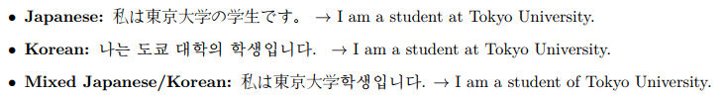
Code-switching in source

Slide 45
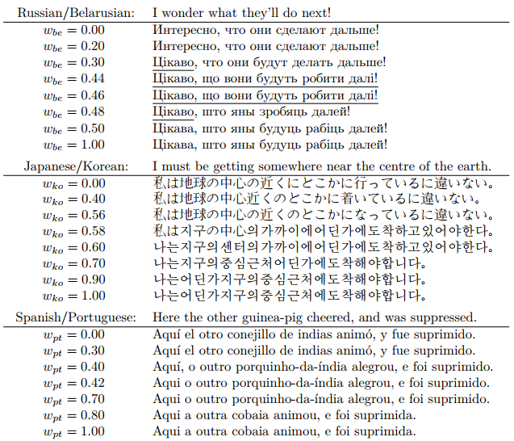
Code-mixing in target

Slide 46
Terminology: Zero-shot learning
Zero-shot = no training data of the target task
Translation: no training data of the language pair
Zero-shot learning = transfer learning without explicit adaptation to target language
All model transfer methods (except relexicalization) can be considered zero-shot learning methods
In opposition to adaptation models
A small amount of training data for the target language is given (cf. Cotterell & Heigold)

Slide 48
Unsupervised machine translation
What if we don’t have parallel data at all?
Use monolingual data ☺
Use multilingual word/sentence embeddings (built without using parallel data, obviously)
M. Artetxe et al. (2018): Unsupervised neural machine translation. Proceedings of ICLR 2018.
G. Lample et al. (2018): Unsupervised machine translation using monolingual corpora only. Proceedings of ICLR 2018.

Slide 49
Unsupervised machine translation
Use zero-shot learning for paraphrasing:
Train on English -> French and French -> English
Test on English -> English
Turn the problem around:
Train on English -> English and French -> French
Test on English -> French
Need to introduce noise in training data to prevent the model from learning to copy-paste
Single system, French and English words are represented in the same vector space

Slide 50
How well does that work? Examples from WMT 2018
Source | Supervised | Unsupervised | Reference
München 1856: Vier Karten, die Ihren Blick auf die Stadt verändern | Munich 1856: four maps that change your view of the city | Munich 1856 - four card, changing their look on the city | Munich 1856: Four maps that will change your view of the city
Eine Irren-Anstalt, wo sich heute Jugendliche begegnen sollen. | An insane institution where young people are supposed to meet today. | A Irren-anstalt where teenagers will interact today. | A mental asylum, where today young people are said to meet.
Eine Gruftkapelle, wo nun für den S-Bahn-Tunnel gegraben wird. | A Gruftkapelle, where the S-Bahn tunnel is now being dug. | A Gruftkapelle, where it will now be dug for the S-bahn-tunnel. | A crypt chapel, where they are now digging tunnels for the S-Bahn.
Kleingärtner bewirtschaften den einstigen Grund von Bauern. | Small gardeners manage the former land of farmers. | Gardeners graze the erstwhile reason by farmers. | Allotment holders cultivate the soil of former farmers.
Die älteste offizielle Karte Münchens fördert spannende Geschichten zu Tage. | The oldest official map of Munich reveals exciting stories. | The oldest official cards Ferguson promotes exciting stories to days. | The oldest official map of Munich brings captivating stories to light.

Slide 52
What resources can we get?
Is there manually annotated training data?
yes
no
Use supervised NLP techniques
Is there relevant training data from other languages?
yes
no
Use cross-lingual learning methods:
Data transfer
Model transfer
Are there monolingual corpora?
yes
no
Use unsupervised NLP techniques
Annotate data
Collect and annotate data
Adapted from Y. Tsvetkov

Slide 53
Enjoy the Midsummer weekend!
Hyvää Juhannusta!

